Slide 1
ONLINE CAR RENTAL MANAGMENT (SE)
By
2110030297- YASHWANTH
2110030348-SAI CHARAN
2110030304-BHANU PRAKASH
2110030308-SHIVA PRASAD
Dr. Sheikh Fahad Ahmad
(Faculty name)

Slide 2
Problem statement and domain
The project's goal is to automate vehicle rental and reservation so that clients don't have to waste time calling and waiting for a vehicle. To convert the manual car rental procedure into a digital method. A customer satisfaction test was used to validate the rental automobile system. As a system development reference, create documents such as Software Requirement Specification (SRS) and Software Design Description.
Nowadays, there is Online Car Rental, which benefits users greatly. A rental service is one where customers come to seek the rental of a rental unit. It is more convenient than paying for the unit's ownership and maintenance. A car rental company lends autos for a price for a few hours, a few days, or a week or more

Slide 3
Existing solutions/ Naïve solutions
In this existing solutions , which is a complicated issue which involves so many steps that contains of:
KNOWNING WHERE CAR IS AVALIBLE
KNOWNING THE DETAILS OF THE OWNER
COMMUNICATING WITH THE OWNER
KNOWNING THE CAR TYPE/MODEL
BARGAINING WITH PRICE
SUBMITTING THE DOCUMENTS
TAKING THE CAR

Slide 4
Proposed Algorithm Design Technique
This project covers a wide range of topics, from business concepts to computer science, and it necessitates the completion of numerous studies in order to meet the project's objectives.
Create a web-based system that allows consumers to register and reserve automobiles online while also allowing the firm to manage its car rental business efficiently. To make the process of renting an automobile easier for consumers.

Slide 5
Login into to the website
Choose the car and the price
Choosing the no.of Days
Submitting the
Documents
Paying the money
Taking the Car

Slide 6
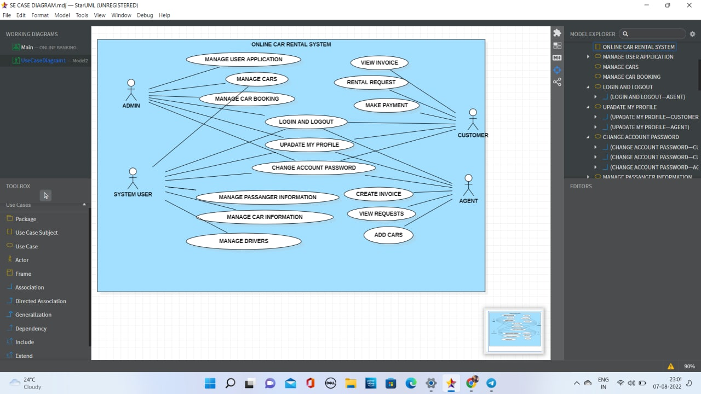
Data Structures needed

Slide 7
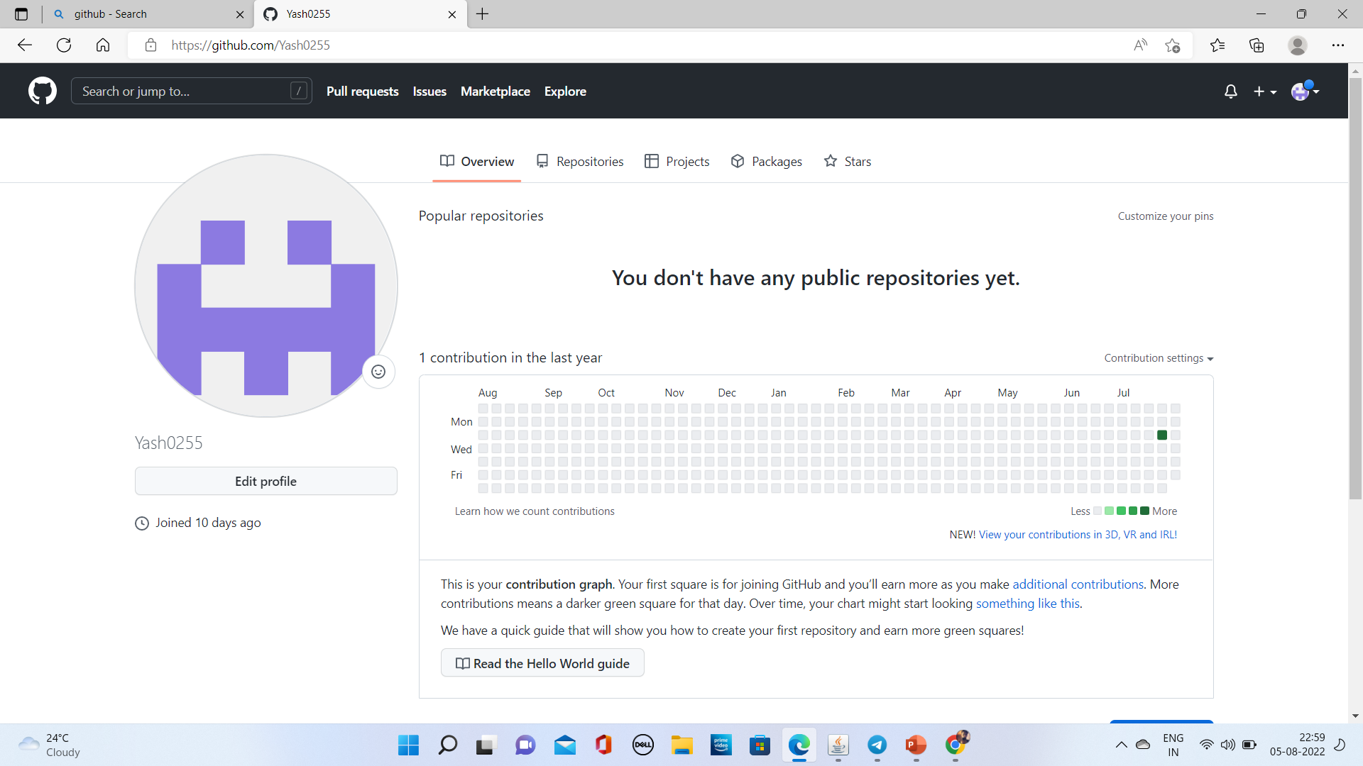
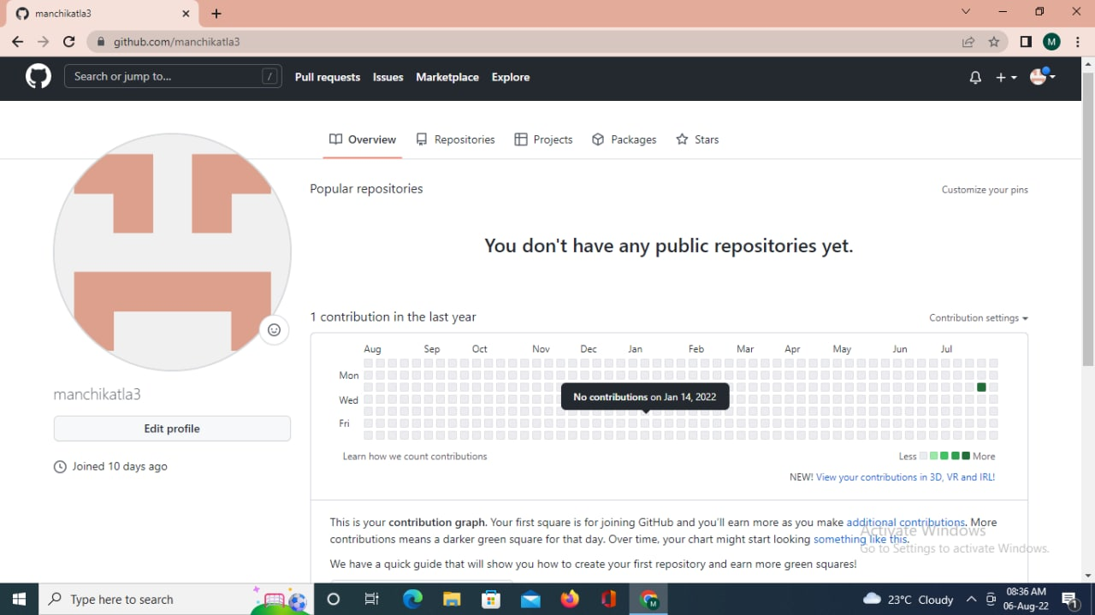
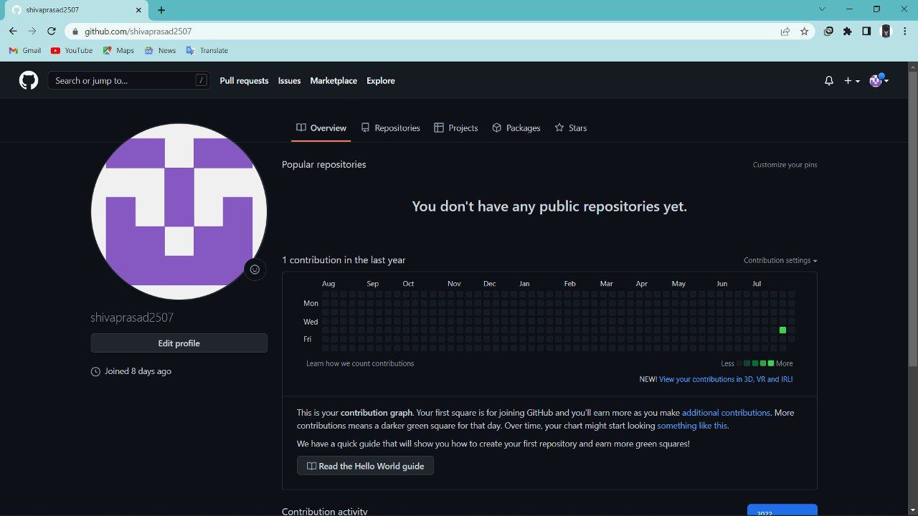
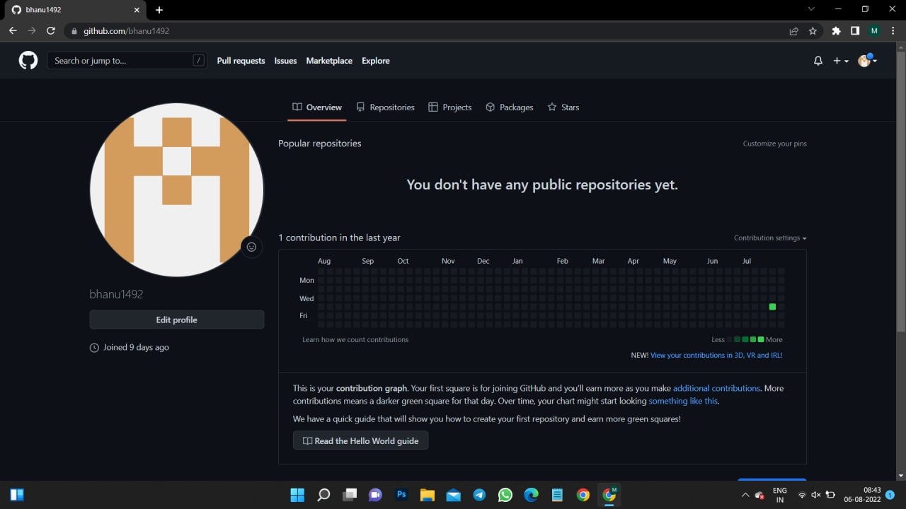
Github setup
https://github.com/bhanu1492/SE-Project

Slide 8
Division of work among the group members
Sai charan – Research
Yashwanth – USE CASE DIAGRAM
Shiva prasad – PPT
Bhanu Prakash – PPT

